Slide 1



COMPUTER GRAPHICS & MULTIMEDIA SYSTEMS SCS1302
UNIT III – PART III

Slide 2
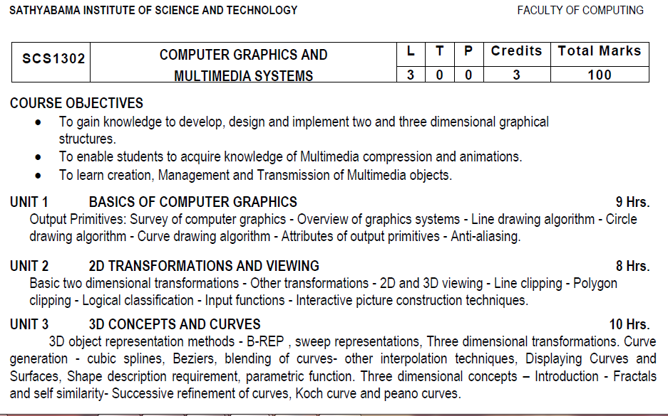
Syllabus

Slide 3
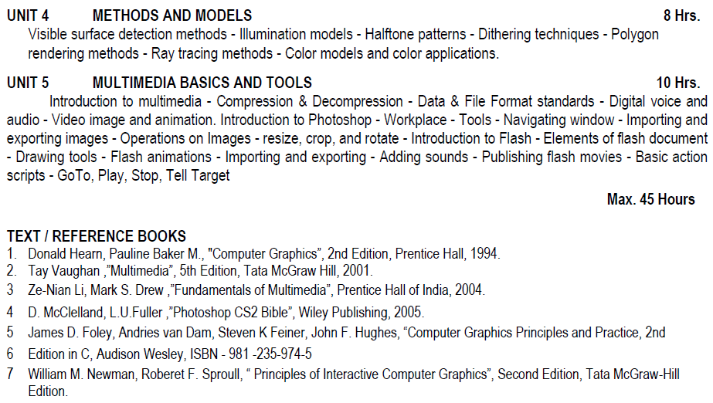
Syllabus

Slide 4
Course Objective(CO)
CO1: Construct lines and circles for the given input.
CO2: Apply 2D transformation techniques to transform the shapes to fit them as per the picture definition.
CO3: Construct splines, curves and perform 3D transformations
CO4: Apply colour and transformation techniques for various applications.
CO5: Analyse the fundamentals of animation, virtual reality, and underlying technologies.
CO6: Develop photo shop applications

Slide 5
Three dimensional concepts
Parallel Projection
Perspective Projection
Depth Cueing
Visible Line and Surface Identification
Surface Rendering
Exploded and Cutaway Views
Three-Dimensional and Stereoscopic Views

Slide 6
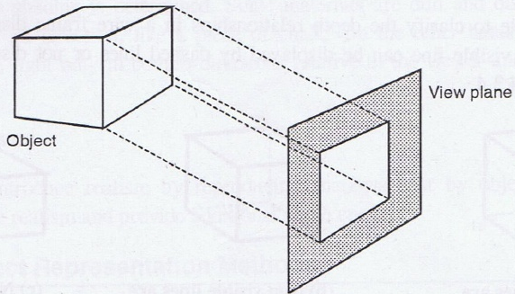
Parallel Projection
In this method a view plane is used. z co-ordinate is discarded. The 3 d view is constructed by extending lines from each vertex on the object until they intersect the view plane. Then connect the projected vertices by line segments which correspond to connections on the original object.

Slide 7
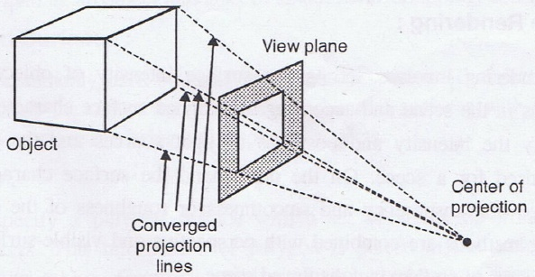
Perspective Projection
Here the lines of projection are not parallel. Instead, they all converge at a single point called the `center of projection' or `projection reference point'. The object positions are transformed to the view plane along these converged projection lines. In this method, Objects farther from the viewing position appear smaller.

Slide 8
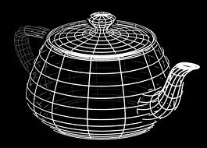
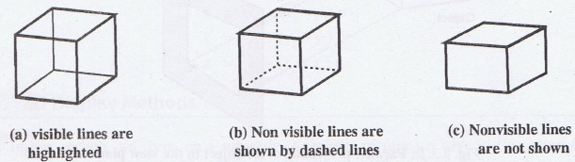
Depth Cueing
Depth information is added. The depth of an object can be represented by the intensity of the image. The parts of the objects closest to the viewing position are displayed with the highest intensities. Objects farther away are displayed with decreasing intensities.
Visible Line and Surface Identification
Visible lines are displayed in different color. Invisible lines either displayed in dashed lines or not at all displayed. Removing invisible lines also removes the info about the backside of the object. Surface rendering can be applied for the visible surfaces, so that hidden surfaces will become obscured.

Slide 9
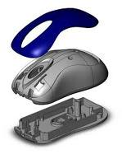
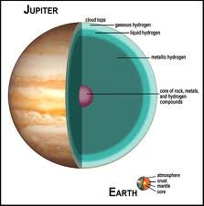
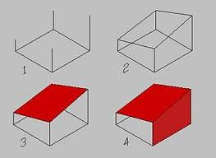
Surface Rendering
Surface intensity of objects will be according to the lighting conditions in the scene and according to assigned surface characteristics. This method is usually combined with the previous method to attain a degree of realism.
Exploded and Cutaway Views
To show the internal details, we can define the object in hierarchical structures.
Exploded view Cutaway View

Slide 10
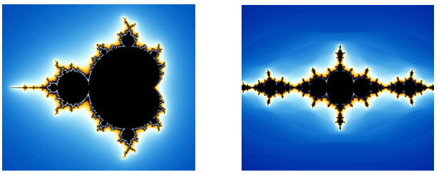
Fractals
Fractals are very complex pictures generated by a computer from a single formula. They are created using iterations. This means one formula is repeated with slightly different values over and over again, taking into account the results from the previous iteration.
Fractals are used in many areas such as −
Astronomy − For analyzing galaxies, rings of Saturn, etc.
Biology/Chemistry − For depicting bacteria cultures, Chemical reactions, human anatomy, molecules, plants,
Others − For depicting clouds, coastline and borderlines, data compression, diffusion, economy, fractal art, fractal music, landscapes, special effect, etc.

Slide 11
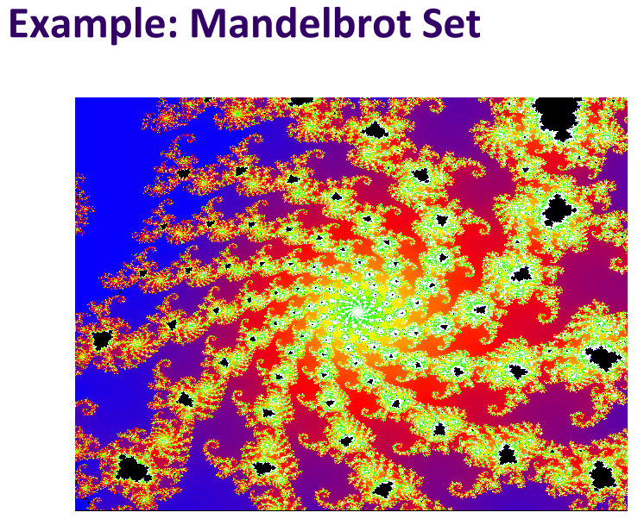
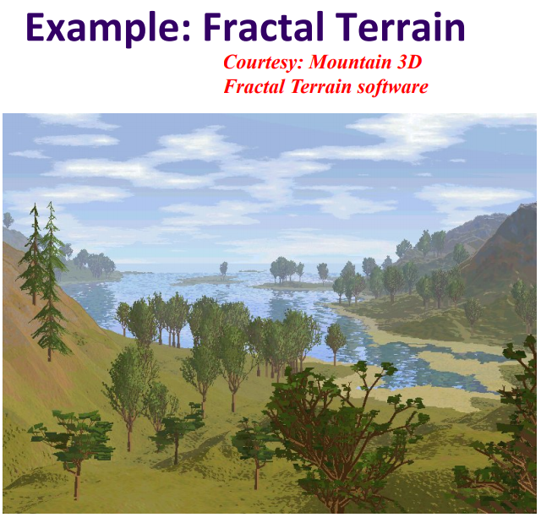

Slide 12
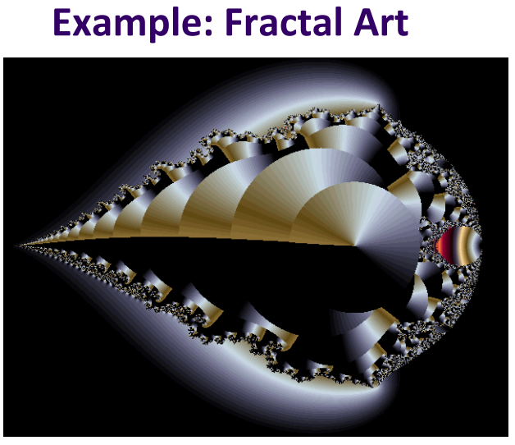
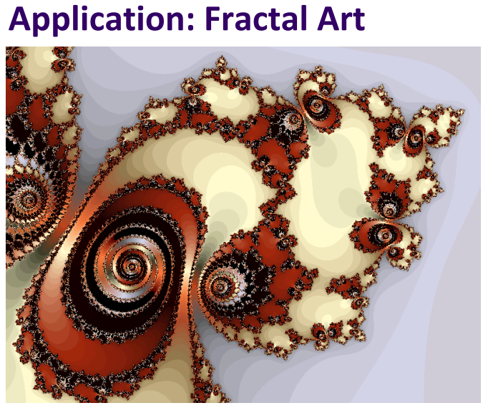

Slide 13
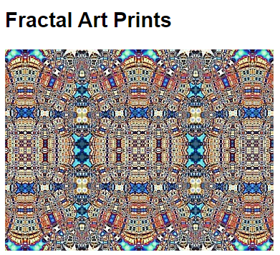
Uses of Fractals
Fractals are used to model soil erosion and to analyze seismic patterns as well.
The most useful use of fractals in computer science is the fractal image compression.
Fractals are used to predict or analyze various biological processes or phenomena such as the growth pattern of bacteria, the pattern of situations such as nerve dendrites, etc.
Fractals are used to describe the roughness of surfaces. A rough surface is characterized by a combination of two different fractals.
Medicine: Biosensor interactions can be studied by using fractals.

Slide 14
Three common techniques for generating fractals
Iterated function systems — These have a fixed geometric replacement rule. These are a method of generating fractals using self-similarity. An IFS image is defined as being the sum of geometric transforms of itself. It turns out that simply specifying the transforms along with a weight for each transform is enough to determine the image.
Examples of this type are the Cantor set, Sierpinski carpet, Sierpinski gasket, Peano curve, Koch snowflake, Harter-Heighway dragon curve, T-Square, Menger sponge, are some examples of such fractals.
Escape-time fractals — These fractals are generated by iterating a formula on each point in a given space. If a point diverges as the formula is iterated, it escapes; otherwise, it remains bounded.
Examples of this type are the Mandelbrot set, the Burning Ship fractal and the Lyapunov fractal.
Random fractals, generated by stochastic rather than deterministic processes.
Examples of this type are the fractal landscapes, Lévy flight and the Brownian tree. The latter yields so-called mass- or dendritic fractals for example, Diffusion Limited Aggregation or Reaction Limited Aggregation clusters.

Slide 15
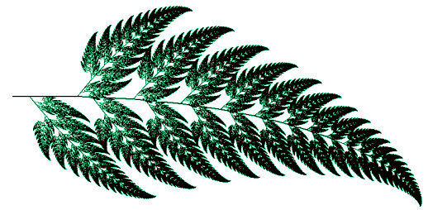
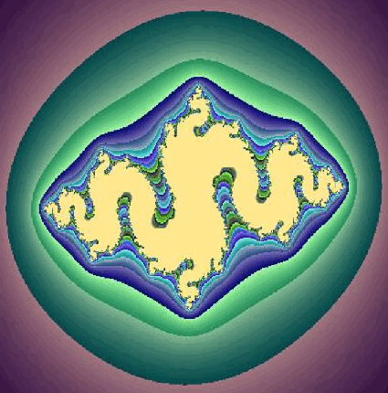
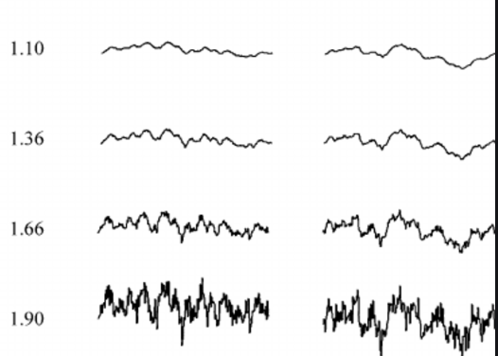
Iterated Function Systems, Escape-time fractals and Random fractals

Slide 16
Types of self-similarity
Fractals can also be classified according to their self-similarity. There are three types of self-similarity found in fractals:
Exact self-similarity — This is the strongest type of self-similarity; the fractal appears identical at different scales. Fractals defined by iterated function systems often display exact self-similarity.
Quasi-self-similarity — This is a loose form of self-similarity; the fractal appears approximately (but not exactly) identical at different scales. Quasi-self-similar fractals contain small copies of the entire fractal in distorted and degenerate forms. Fractals defined by recurrence relations are usually quasi-self-similar but not exactly self-similar.
Statistical self-similarity — This is the weakest type of self-similarity; the fractal has numerical or statistical measures which are preserved across scales. Most reasonable definitions of "fractal" trivially imply some form of statistical self-similarity. (Fractal dimension itself is a numerical measure which is preserved across scales.) Random fractals are examples of fractals which are statistically self-similar, but neither exactly nor quasi-self-similar.

Slide 17
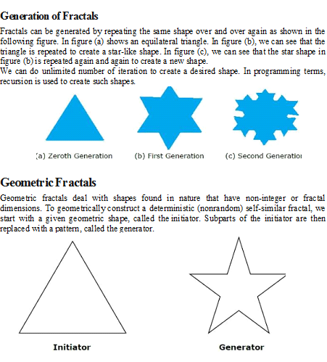
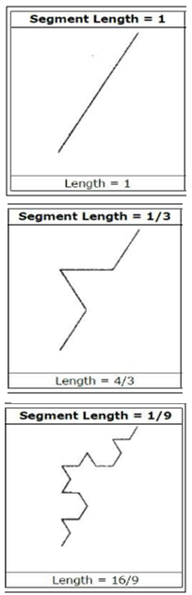
Fractals

Slide 18
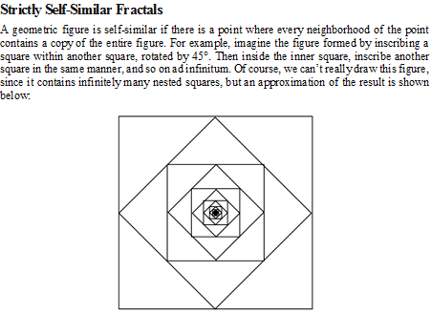
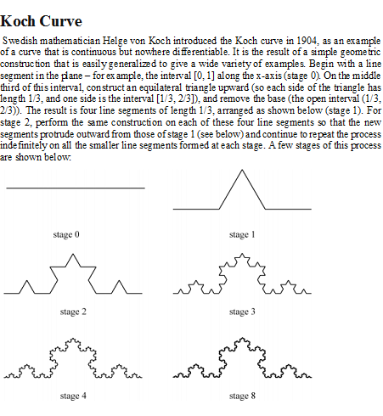
Fractals

Slide 19
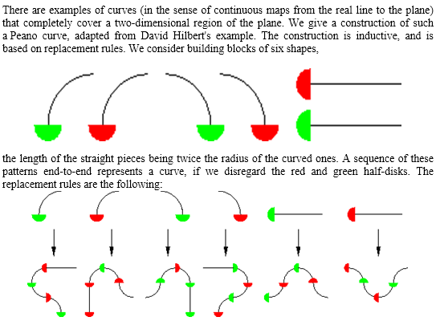
Peano Curve and Fractal Curves

Slide 20
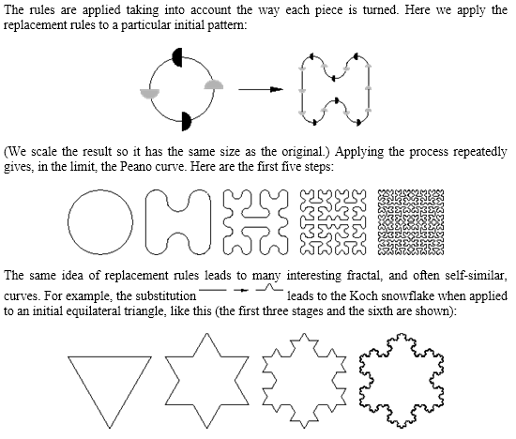
Peano Curve and Fractal Curves

Slide 21
Fractals
https://www.youtube.com/watch?v=BTiZD7p_oTc
https://www.youtube.com/watch?v=WFtTdf3I6Ug
https://www.youtube.com/watch?v=XwWyTts06tU
Mathematical expressions to generate pretty pictures
Evaluate math functions to create drawings (approach infinity ‐> converge to image)
Utilizes recursion on computers
Popularized by Benoit Mandelbrot (Yale university) 
Defined in terms of self‐similarity

Slide 22
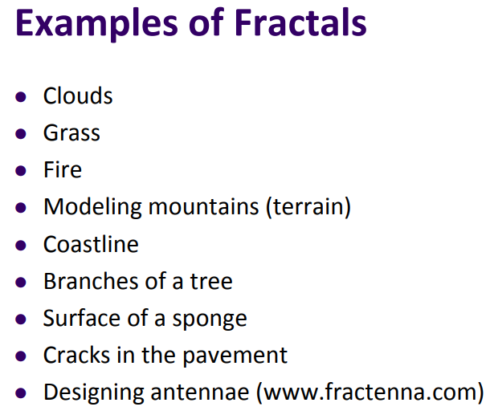
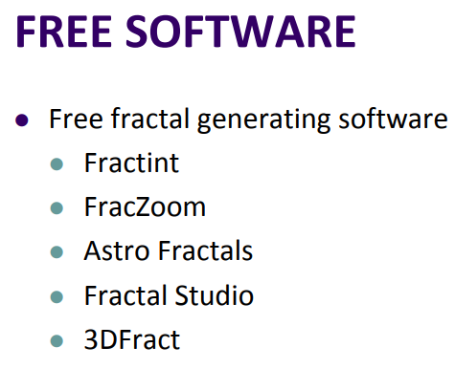

Slide 23
Thank You

